Slide 1


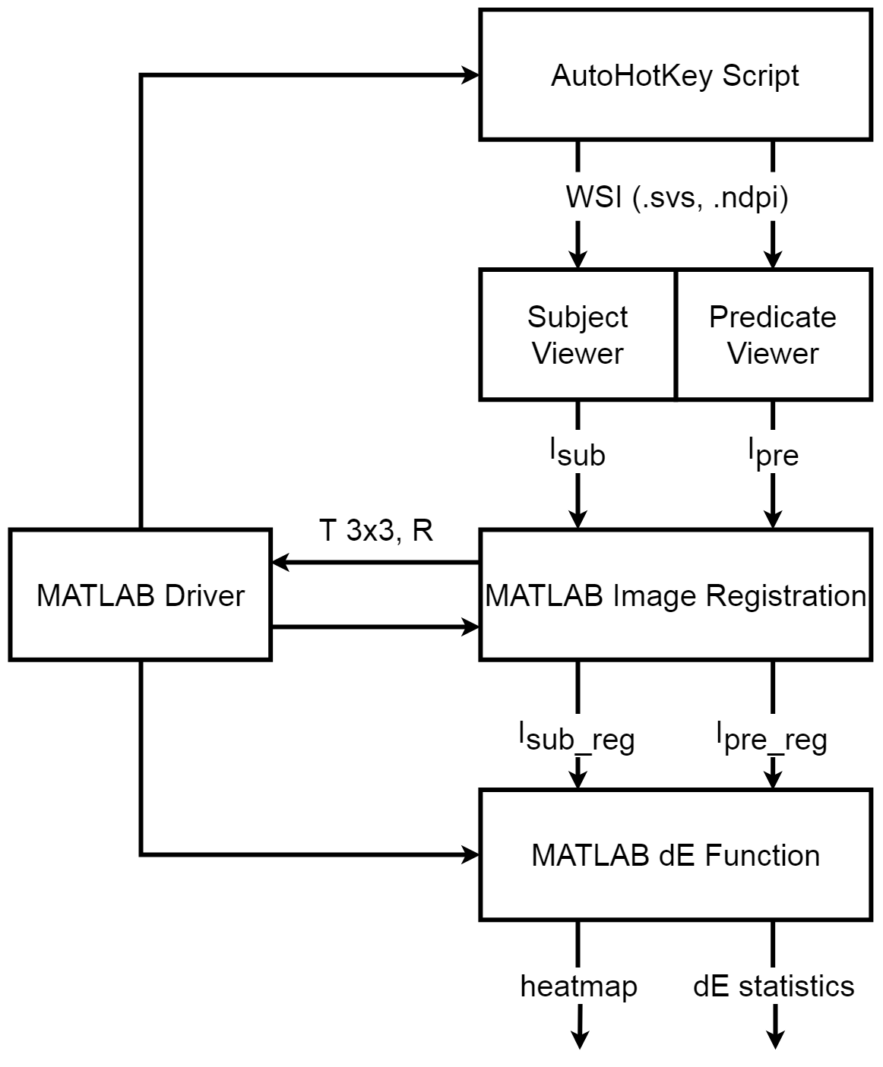
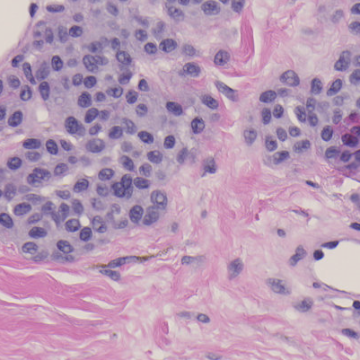
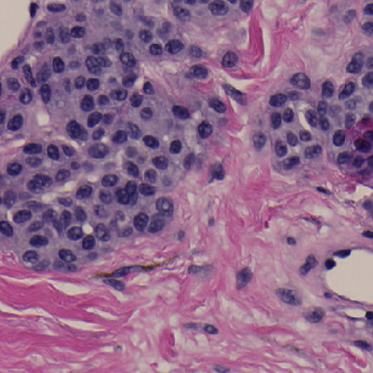
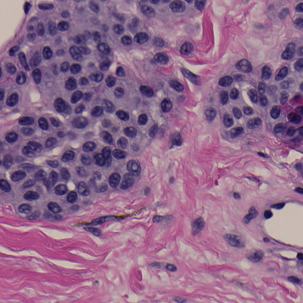





Third-party whole-slide image viewers do not produce the same image
Samuel Lam¹, Qi Gong², Wei-Chung Cheng³
¹University of Maryland, College Park; ²CDRH/OSEL/DIDSR, ³CDRH/OSEL/DIDSR
REGULATORY RELEVANCE
METHODOLOGY
Determine testing data required to demonstrate performance equivalence between WSI viewer devices.
AutoHotKey Script:
Use different viewers to open the same WSI
Use a keyboard/mouse event generator to interact with the viewers to obtain the ROI
Capture the screenshot in Windows (this captures color information in the digital domain and does not involve the display) [1]
MATLAB:
Run registration; check registration accuracy
Calculate color difference ∆E for each pixel
Report statistics (mean, standard deviation)
Generate graphs for display
ABSTRACT
In this study, a software program, the Image Viewer Integrity Evaluation System (IVIES), was developed to compare two image viewers on the pixel level and report any measured color differences. Four freely available image viewers were inspected with the test method. The results show that some of the viewers rendered the whole slide images differently compared with the factory image viewer.
RESULTS
BACKGROUND
NDP.view2
ASAP
QuPath
Sedeen
A WSI system used in digital pathology consists of the scanner, image viewer, and display components. Recently, some independent image viewers were submitted by third-party companies to replace the factory image viewer component used in the predicate device. To demonstrate substantial equivalence between the former and the latter, sponsors were expected to provide bench testing data for review. However, the sponsors frequently did not test their image viewers adequately for image quality.
FINDINGS
NDP.view2 and Sedeen generated similar images
ASAP and QuPath generated similar images
Large color differences between the two groups
Use of color profile is questionable
JPEG compression artifacts are prominent when comparing certain pairs of viewers.
Blank/void areas remain very similar between viewers.
RESEARCH QUESTION
REFERENCES
Do different WSI viewers generate identical images for the same WSI file?
Sun, C. (2017, August). How Much Can Bad Display Cost?. OSEL Annual Student Science Poster Exhibit, White Oak, MD.
SUBJECTS
NDP.View2 (Hamamatsu): reference
Sedeen (PathCore): DICOM WG26 chair
QuPath (Queen’s University Belfast)
ASAP (Radboud University)
ACKNOWLEDGEMENTS
This study was supported by ORISE. The mention of commercial products herein is not to be construed as either an actual or implied endorsement of such products by the Department of Health and Human Services. We are grateful to Jonathan Boswell for helping in setting up this study.

